Slide 1
Determining the Best Features of a House using a Linear Regression Model
By: Graham Haun

Slide 2
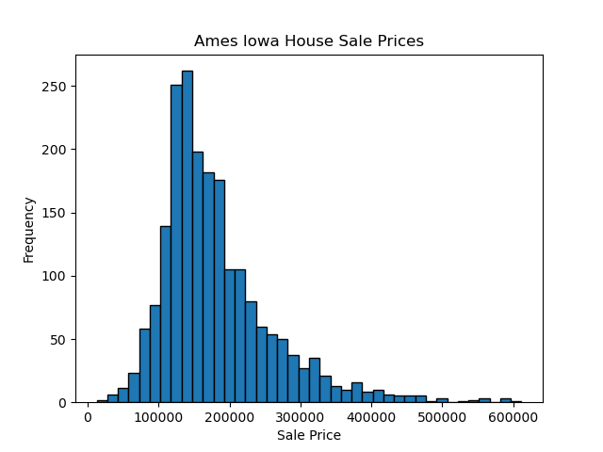
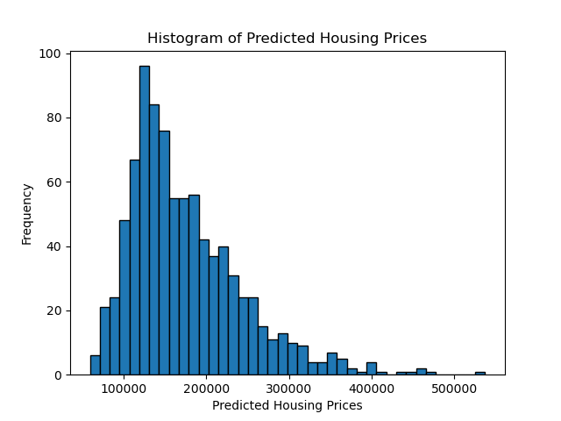
The Sale Price Comparisons
Mean: $176,373
Mean: $175,341

Slide 3
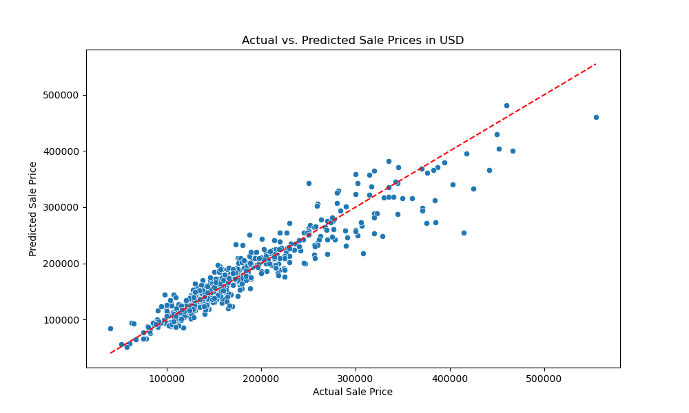
Actual vs Predicted Sales Price

Slide 4
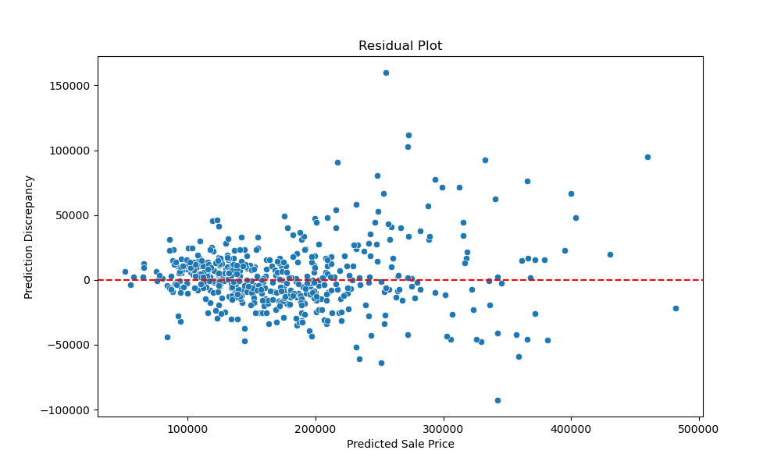
The Errors

Slide 5
10 Random Predictions from the Model

Slide 6
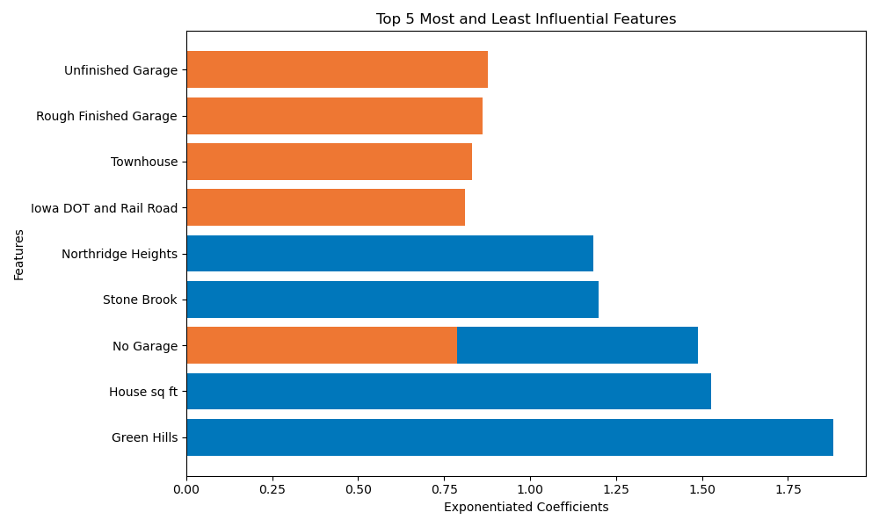
Best and Worst Features

